Slide 1
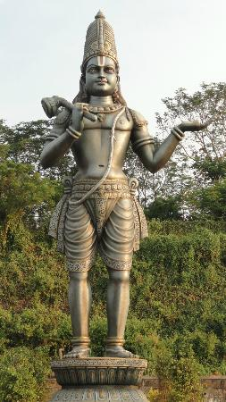
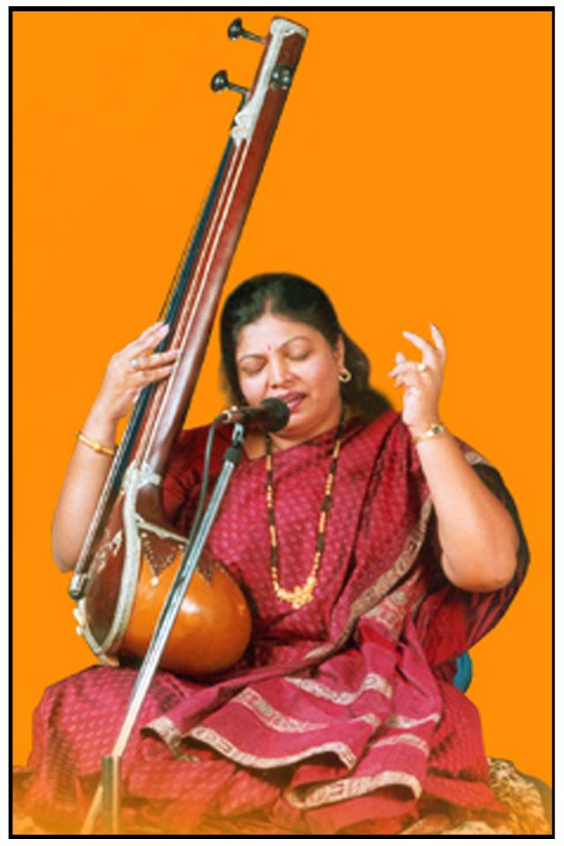
ANNAMACHARYA BHAVANA VAHINI
Presents
VESAVI VENNELA
A Musical journey to the abode of the Lord..
Annamacharya Keerthanalu
Summer Workshop
for Kids and Adults
by
Padmasree Dr. Shobha Raju
Dates: August 28th to 30th
Venue:
Sri Datta Sai Temple
1901 San Ramon Valley Blvd
San Ramon,CA 94538
Timings:
Fri, Aug 28th - 6:00 pm to 8:00 pm
Sat, Aug 29th - 6:00 pm to 8:00 pm
Sun, Aug 30th - 10:00 am to 12:00 pm
Contacts:
Valli Mocherla 925 353 6464
Shobha Moola 925 357 0008
Email:srinandaka2015@gmail.com

